Slide 1
MINIMIZING ROAD ACCIDENTS ON RAINY DAYS
Sheila Koo
DSI 39

Slide 2
Higher than USA, Canada and Australia etc.
Source: https://www.valuechampion.sg/probability-car-accident
Notes:
Global measure
This finding is further backed by the increase in car insurance claims, where despite fewer accidents, car insurance claims increased by 11.8% in 2017, leading insurers to believe accidents have become more severe.

Slide 3

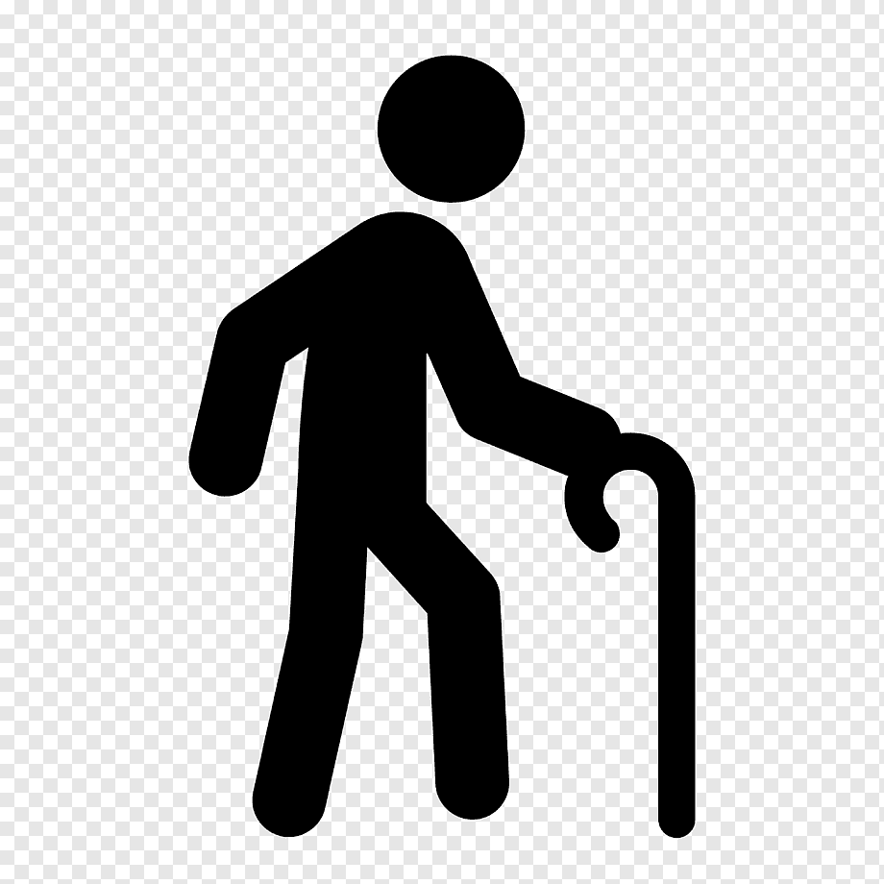
overall fatalities
pedestrian fatalities
motorcyclists & pillion riders
elderly
Source: https://www.budgetdirect.com.sg/car-insurance/research/road-accident-statistics-in-singapore

Slide 4
Problem statement:
Rainy days can impede our navigation skills due to:
more slippery surfaces
reduced visibility
To what extent does weather play a part in road safety?
How can we minimize road accidents stemmed from rainy weather?
Note:
A rain day is defined as a day with 0.2 mm rainfall recorded at a rainfall station (NEA, 2023)

Slide 5
So what?
Aim | Research
Find out if rainy days affect number of road accident casualties | No. of rainy days vs no. of casualties
Find out if rainy days aggravate road accidents | No. of rainy days vs no. of fatalities
Identify type of vehicles more prone to road accident | No. of casualties by vehicle types
Provide recommendations to improve road safety
Note:
The research was conducted using datasets from Jan 2010 – Dec 2019 (10 years).
Datasets from 2020 onwards were excluded due to the effects of Covid-19.
Personal Mobile Devices (PMD) were also removed as they only came into existence from 2017 onwards.
Notes:
Explain why we’re looking at number of rainy days
Casualties = Death + Injured

Slide 6
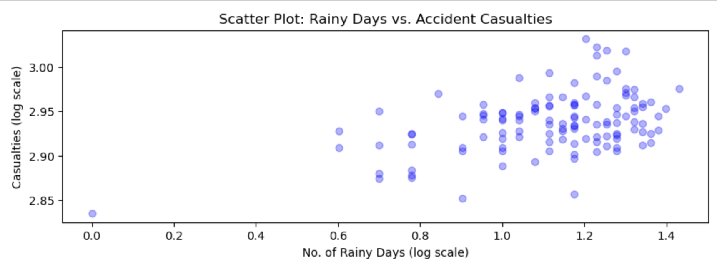
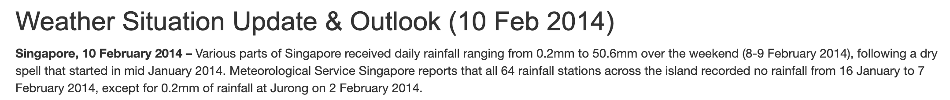
Outlier
Feb 2014
Correlation =
0.65
Source: http://www.weather.gov.sg/weather-situation-update-outlook-10-feb-2014/
Notes:
Meteorological Service Singapore

Slide 7
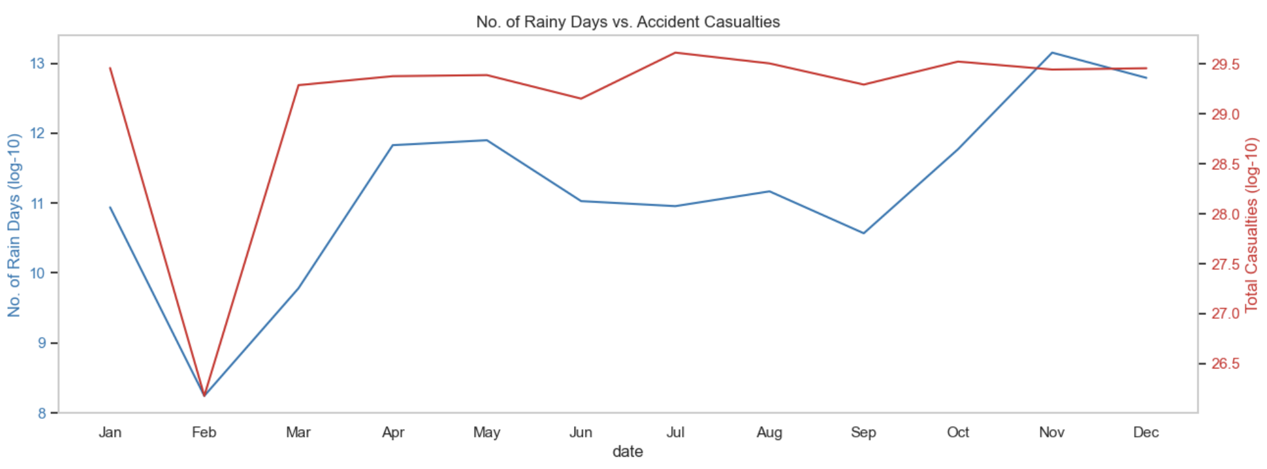
No. of rainy days vs no. of casualties
Strong correlation =
0.73
Chart: Aggregated no. of rainy days and casualties of each month over 2010-2019
- Move in different directions
- Months that requires attention
Notes:
Strong correlation
Generally move in the same direction, exception of:
Jun-Jul: Accidents caused by other factors
Oct-Nov: Holiday season
Jan (2011, 2018): High rainfall and flooding
Mar-May (La Nina): High no. of casualties with relatively high no. of rainy days

Slide 8
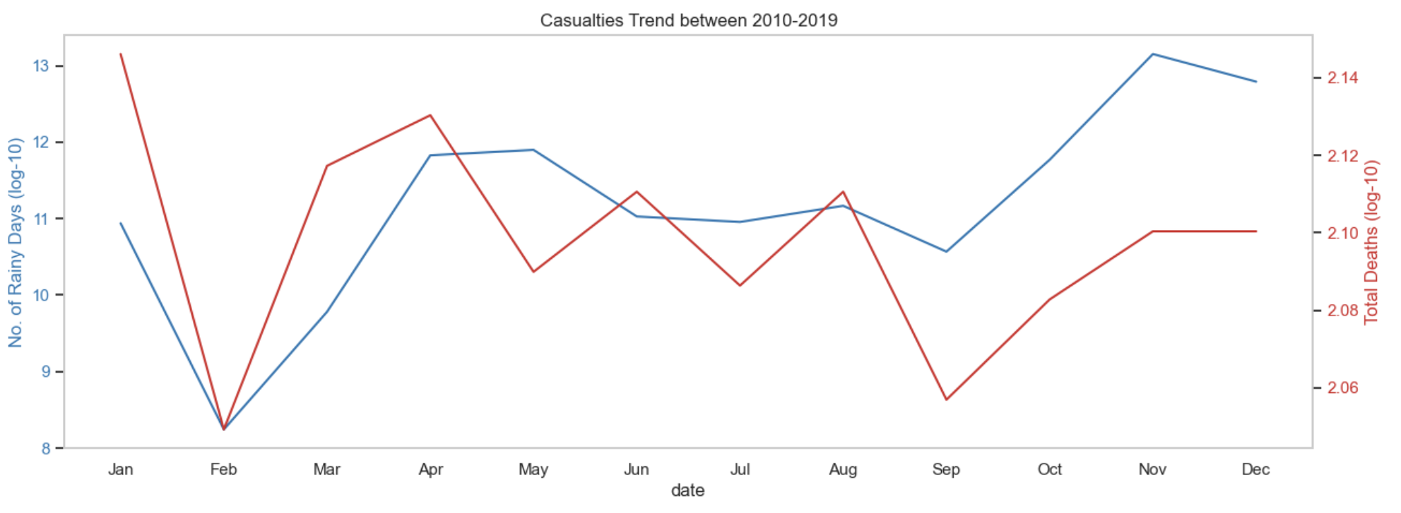
No. of rainy days vs no. of fatalities
Moderate correlation =
0.58
Chart: Aggregated no. of rainy days and fatalities of each month over 2010-2019
- Move in different directions
- Months that requires attention
Notes:
Very weak correlation
X Apr to Jul
Jan, Mar and Apr: High fatality rates with relatively high no. of rainy days
Death not from rainy days (alcohol consumption, disobeying traffic rules etc.)

Slide 9
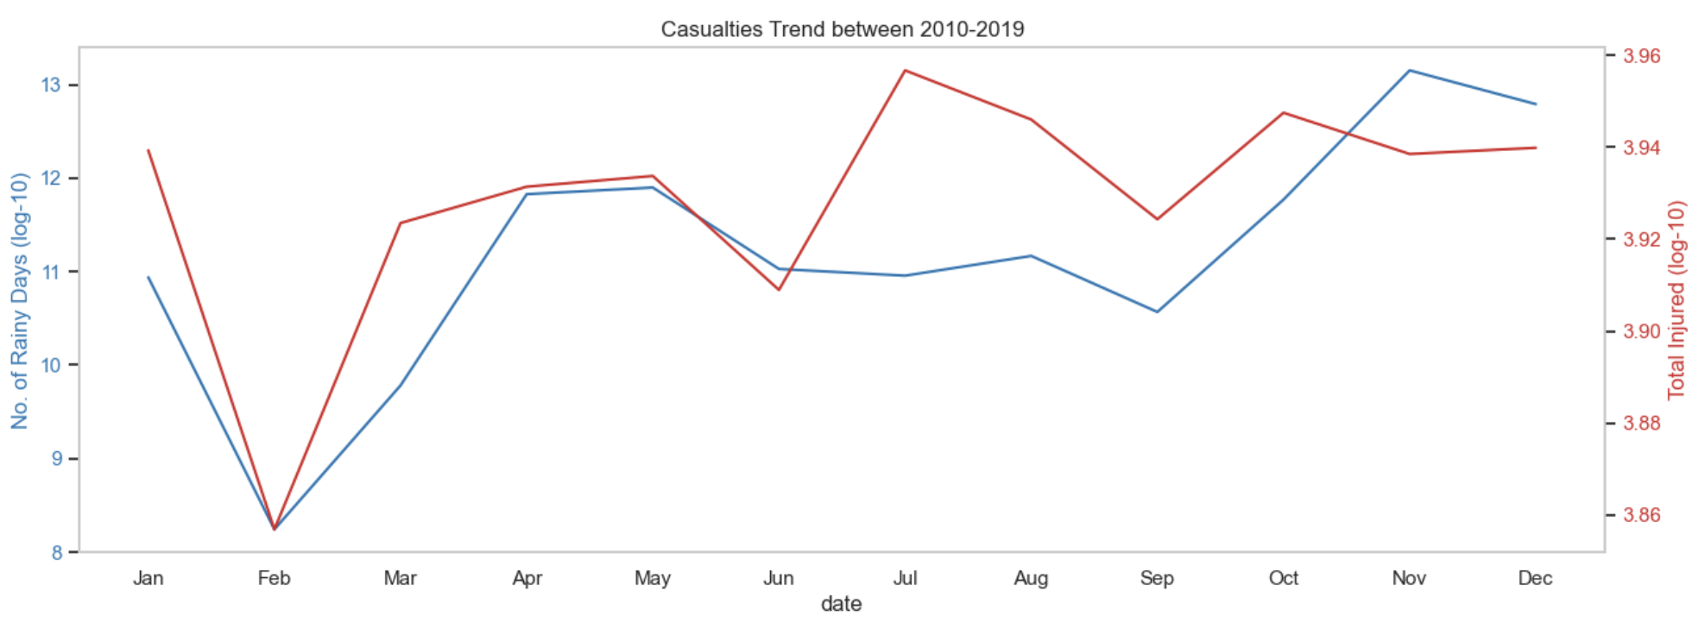
No. of rainy days vs no. of injured
High correlation =
0.73
Chart: Aggregated no. of rainy days and injured of each month over 2010-2019
- Move in different directions
- Months that requires attention
Notes:
Moderately strong correlation
Jan, Mar, Apr, May, Aug and Oct: High no. of injured with relatively high no. of rainy days
No. of injured cases contributed to the high correlation between no. of rainy days and no of casualties
High numbers of injured people in aa handful of months

Slide 10
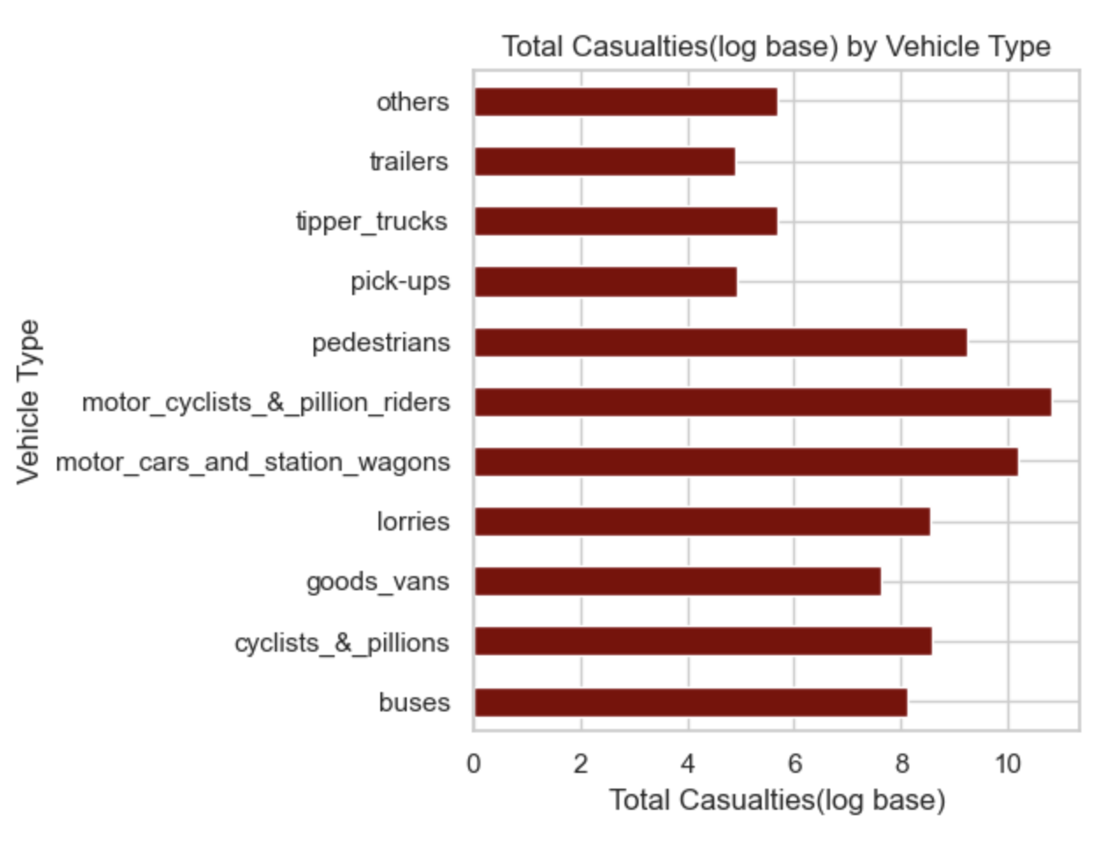
No. of casualties by vehicle types
Top 3 vehicle types
Motorcyclists and pillion riders Motor cars and station wagons Pedestrians

Slide 11
Conclusion
Rainy days have a significant impact on the number of road accident casualties that result in injuries but not fatalities
Fatalities are likely affected by other factors
Jan, Mar and Apr consistently had high number of casualties with relatively high number of rainy days
Organisations should tailor road safety measures to motorcyclists and pillion riders, motor cars and station wagons and pedestrians

Slide 12


Recommendations
Who | When | What | Targeted at
LTA | Jan, Mar, Apr | Regular checks on clearer signages, anti-skid surfaces Regular road maintenance
Town Council, Traffic Police, IMDA | Throughout the year | Workshops on road safety Introduce apps that can help drivers be more informed of road/weather conditions
PUB | Jan, Mar, Apr | More frequent checks on our drainage system during rainy season
App development companies | Throughout the year | Real-time traffic & weather monitoring app Suggest alternative routes Platform to swiftly inform relevant organisations of poor road conditions

Slide 13
Limitations/Future research
Accuracy
Other factors
Geolocation data
How many road accidents happened on a rainy day?
Other causes of road accidents?
Are specific locations more prone to accidents because of rain?

Slide 14
RESOURCES
https://www.budgetdirect.com.sg/car-insurance/research/road-accident-statistics-in-singapore
https://www.directasia.com/blog/reduce-risk-road-accidents-singapore
https://www.motorist.sg/article/173/the-5-most-common-causes-for-road-accidents-in-singapore
https://msgt.com.sg/accident-hotspots-in-singapore-to-watch-out-for/
http://www.smj.org.sg/article/geospatial-analysis-severe-road-traffic-accidents-singapore-2013%E2%80%932014
https://tablebuilder.singstat.gov.sg/
https://www.valuechampion.sg/probability-car-accident
https://www.weather.gov.sg/wp-content/uploads/2020/03/Annual-Climate-Assessment-Report-2019.pdf

